Slide 1
At the Edge: Sleep Stage Classification
Alex Anderson-McLeod, Kuba Jerzmanowski, Kasra Korminejad
CSCE 714
1
University of South Carolina

Slide 2
What Is Sleep Stage Classification?
Sleep cycles through four to five distinct, measurable physiological stages
Stages: Wake, N1 (light), N2 (light), N3 (slow-wave/deep), REM [6]
Each stage exhibits characteristic EEG signatures — alpha waves, delta waves, sleep spindles, K-complexes
Accurate staging reveals sleep architecture and its downstream effects on health and cognition

Slide 3
Why Does It Matter?
Sleep stage composition is a direct biomarker for downstream health outcomes [5]
Insufficient N3 (slow-wave sleep) → elevated Alzheimer’s and metabolic disease risk [7]
REM deficiency → mood dysregulation [8]
To study on a population level and To monitor individual at home, must be developed.

Slide 4
The Gold Standard: Clinical PSG
Polysomnography (PSG) — 20+ channels: EEG, EOG, EMG, cardiorespiratory monitoring
Multi-modal, full-head signal capture → high-fidelity staging across all AASM categories
Manual inter-rater Cohen’s κ ≈ 0.68–0.76 [9,10]
Automated classification accuracy: κ of up to 0.80 [10]
Same as humans
Requires a sleep clinic, trained technician, overnight stay → not viable for home use

Slide 5
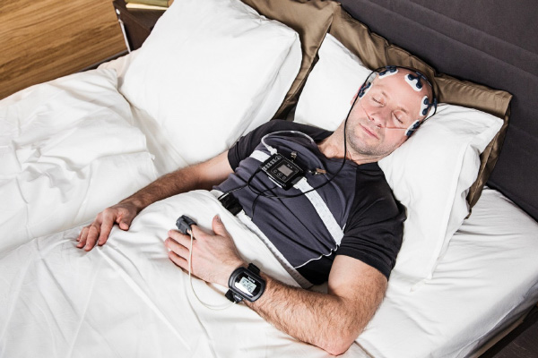
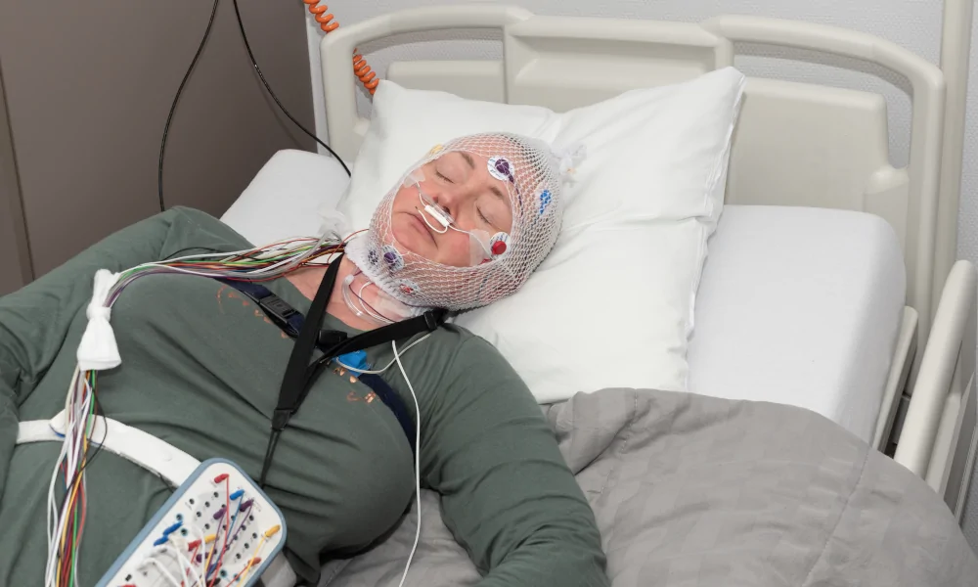
Image credit: https://www.drindububnapulmonologist.com/images/polysomnography.jpg
Image credit: https://sleeppsychiatrist.com/wp-content/uploads/2024/10/polysomnography-sleep-test.webp

Slide 6
Smart Watches: Ubiquitous but Imprecise
Now standard in consumer wearables — no additional hardware required
Rely on PPG (photoplethysmography) and accelerometry as proxies for neural activity
Cohen’s κ = 0.21–0.53 across six commercial devices [1]
Adequate for coarse sleep/wake detection
EEG is a significantly more accurate method of classification [2-6,9,10], although also more intrusive.
CSCE 714
6
University of South Carolina

Slide 7
Our Approach: Wearable Single-Channel EEG
Custom lightweight headset — single EEG channel (two electrodes), designed for home use
Captures direct neural signals — fundamentally more informative than wrist PPG
Less intrusive than clinical PSG — practical for nightly, longitudinal monitoring
Projected accuracy: ~80–86%, consistent with comparable single-channel EEG studies [2–4]
Edge inference on Raspberry Pi — self-contained, no network or cloud dependency
CSCE 714
7
University of South Carolina

Slide 8
Why It Belongs on the Edge
Privacy — EEG contains sensitive biometric data; local processing avoids cloud transmission
Connectivity independence — functions without a network connection
Real-time latency — no round-trip delay to a remote server
Accessibility — compact, self-contained form factor suitable for home deployment
CSCE 714
8
University of South Carolina

Slide 9
Available Sleep EEG Datasets
SleepEDF — most widely used benchmark; annotated by AASM sleep stage
Fpz-Cz probe locations (comfortable); two versions: SleepEDF-20 (20 subjects) and SleepEDF-78 (78 subjects)
SHHS (Sleep Heart Health Study) — large-scale, but uses uncomfortable probe placement
MASS (Montreal Archive of Sleep Studies) — requires institutional access review
Selected: SleepEDF — openly accessible, widely benchmarked, compatible probe locations
CSCE 714
9
University of South Carolina

Slide 10
Prior Research
CSCE 714
10
University of South Carolina

Slide 11
A lightweight automatic sleep staging method for children using single‑channel EEG based on edge artificial intelligence (2022)
Focuses on children, different EEG patterns from adults in terms of
Emphasizes the aforementioned privacy benefits of edge devices for EEG systems
Used both Sleep-EDF and a custom dataset of child subjects
SleepEDF used Fpz-Cz probe locations, custom dataset used a variety of locations
Attempts to classify sleep into Wake, N1, N2, N3, and REM categories
All experiments were run on a high-end PC
CSCE 714
11
University of South Carolina

Slide 12
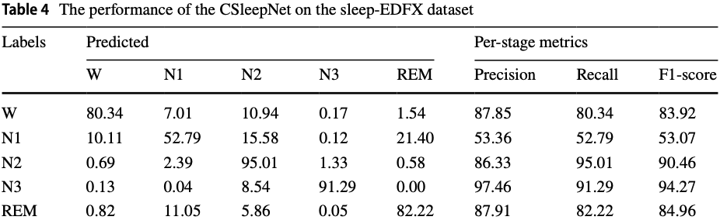
A lightweight automatic sleep staging method for children using single‑channel EEG based on edge artificial intelligence (Continued)
Signals processed in time domain, not frequency domain
Input data divided into 30s epochs
Each epoch normalized with 0 mean and unit variance, then fed into model
Accuracy on custom dataset was 83.06%, accuracy on SleepEDF was 86.41%
Image credit: L. Zhu, C. Wang, Z. He, and Y. Zhang, “A lightweight automatic sleep staging method for children using single-channel EEG based on edge artificial intelligence,” World Wide Web, Dec. 2021, doi: https://doi.org/10.1007/s11280-021-00983-3.
CSCE 714
12
University of South Carolina

Slide 13
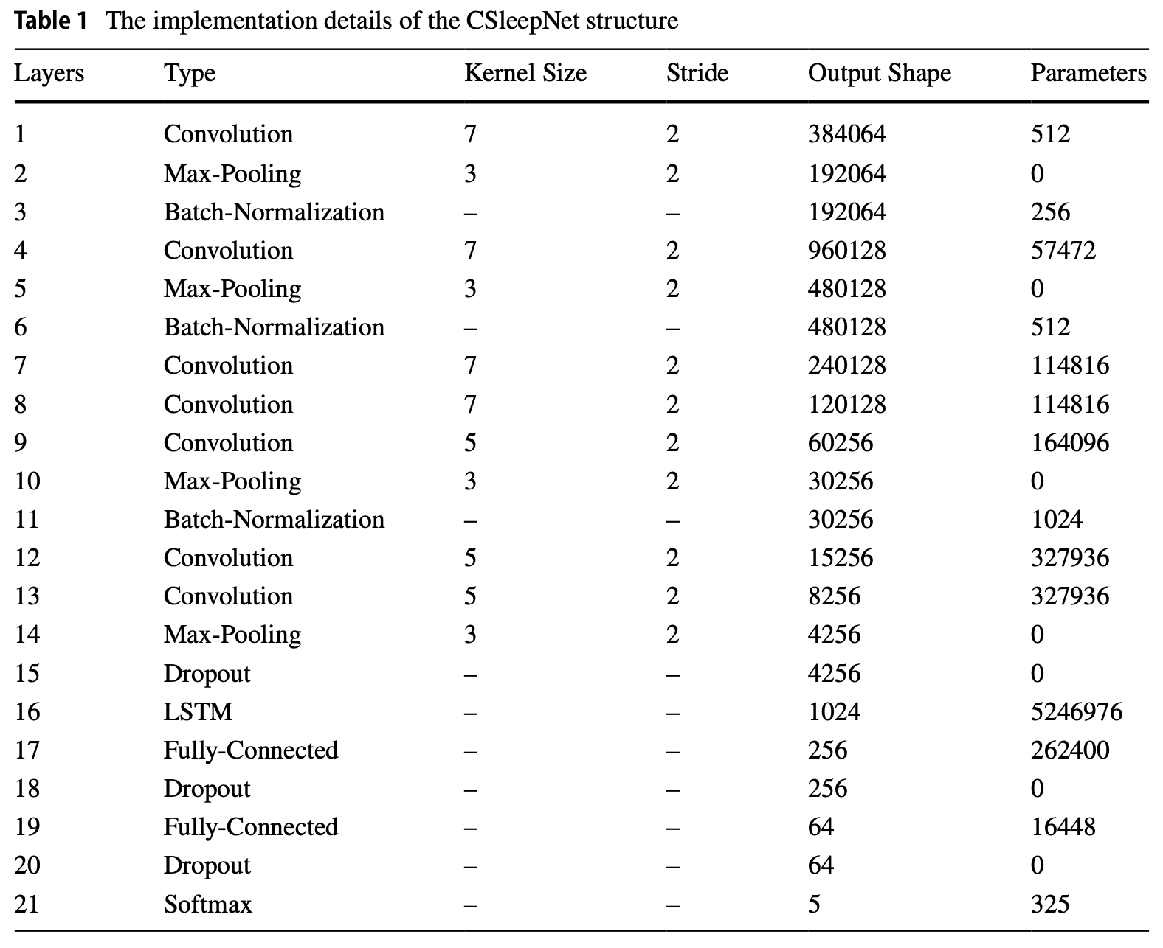
A lightweight automatic sleep staging method for children using single‑channel EEG based on edge artificial intelligence (Continued)
Image credit: L. Zhu, C. Wang, Z. He, and Y. Zhang, “A lightweight automatic sleep staging method for children using single-channel EEG based on edge artificial intelligence,” World Wide Web, Dec. 2021, doi: https://doi.org/10.1007/s11280-021-00983-3.
All activation functions are ReLU
CSCE 714
13
University of South Carolina

Slide 14
A PORTABLE GUI BASED SLEEP DISORDER SYSTEM CLASSIFICATION BASED ON CONVOLUTION NEURAL NETWORKS (CNN) IN RASPBERRY PI (2021)
Focuses on sleep disorders; datasets not relevant to us
Binary classification between “healthy” and “unhealthy”
Deploys on a Raspberry Pi (edge AI)
Uses a single EEG channel
Signals processed in time domain
EEG data divided into 30s epochs and filtered for noise before being fed into model
Accuracy of 92% for sleep apnea and 89% for insomnia
CSCE 714
14
University of South Carolina

Slide 15
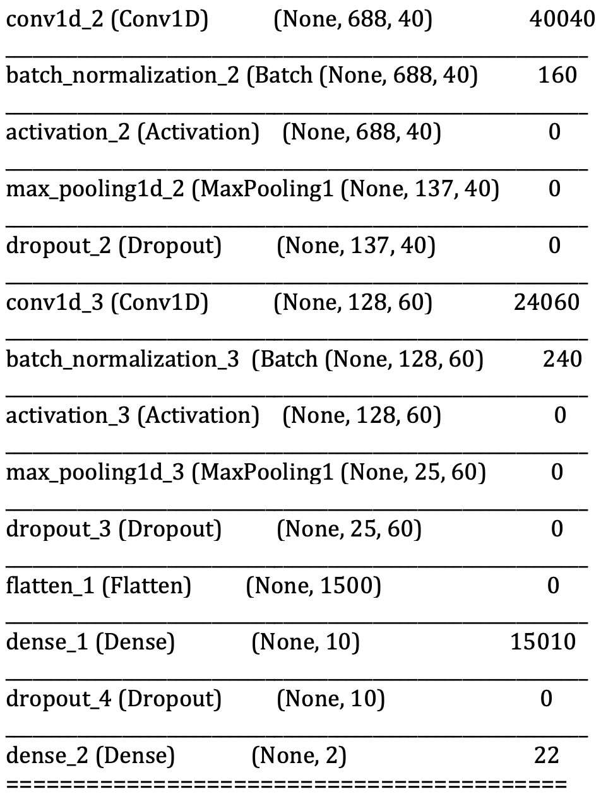
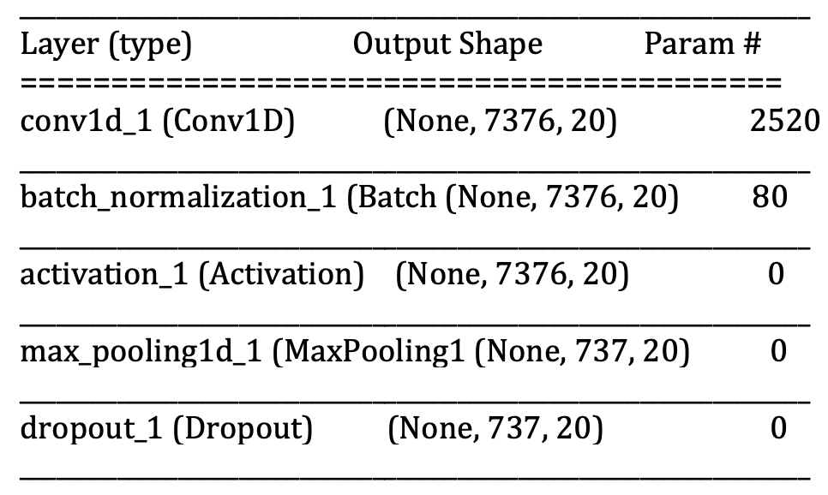
A PORTABLE GUI BASED SLEEP DISORDER SYSTEM CLASSIFICATION BASED ON CONVOLUTION NEURAL NETWORKS (CNN) IN RASPBERRY PI (Continued)
All activation functions are ReLU
Image credit: A. Atianashie Miracle, E. Armah, and N. Mohammed, “A portable GUI based sleep disorder system classification based on convolution neural networks (CNN) in Raspberry Pi,” J. Eng. Appl. Sci. Humanities, vol. 6, pp. 13–23, 2021.
CSCE 714
15
University of South Carolina

Slide 16
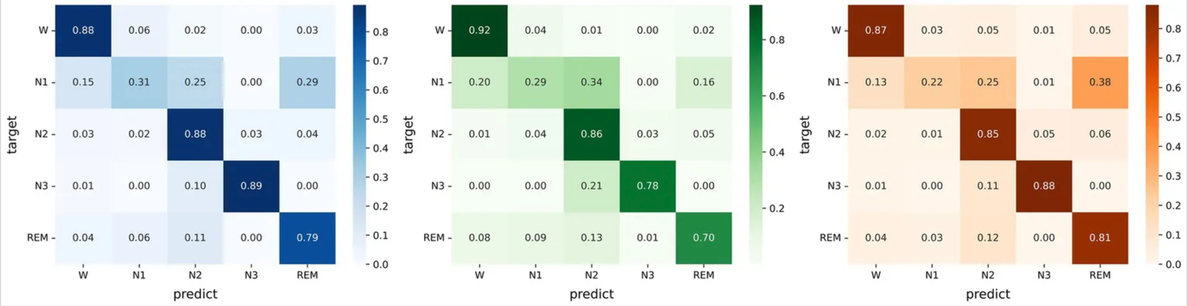
Micro SleepNet: efficient deep learning model for mobile terminal real-time sleep staging (2023)
Deployed on a Snapdragon-based Android device, inference latency of 2.8ms
Model trained and tested on SleepEDF and SHHS datasets
Used Fpz-Cz probes on SleepEDF, C4-A1 probes on SHHS
Data divided into 30s epochs as usual
No preprocessing whatsoever on the SleepEDF data
Some preprocessing done on SHHS to correct for a class imbalance
Accuracy of 83.3 on SHHS, 79.5% on SleepEDF-78, and 82.8% on SleepEDF-20
Image credit: G. Liu et al., “Micro SleepNet: efficient deep learning model for mobile terminal real-time sleep staging,” Frontiers in neuroscience, vol. 17, Jul. 2023, doi: https://doi.org/10.3389/fnins.2023.1218072.
Left: SleepEDF-20
Center: SleepEDF-78
Right: SHHS
CSCE 714
16
University of South Carolina

Slide 17
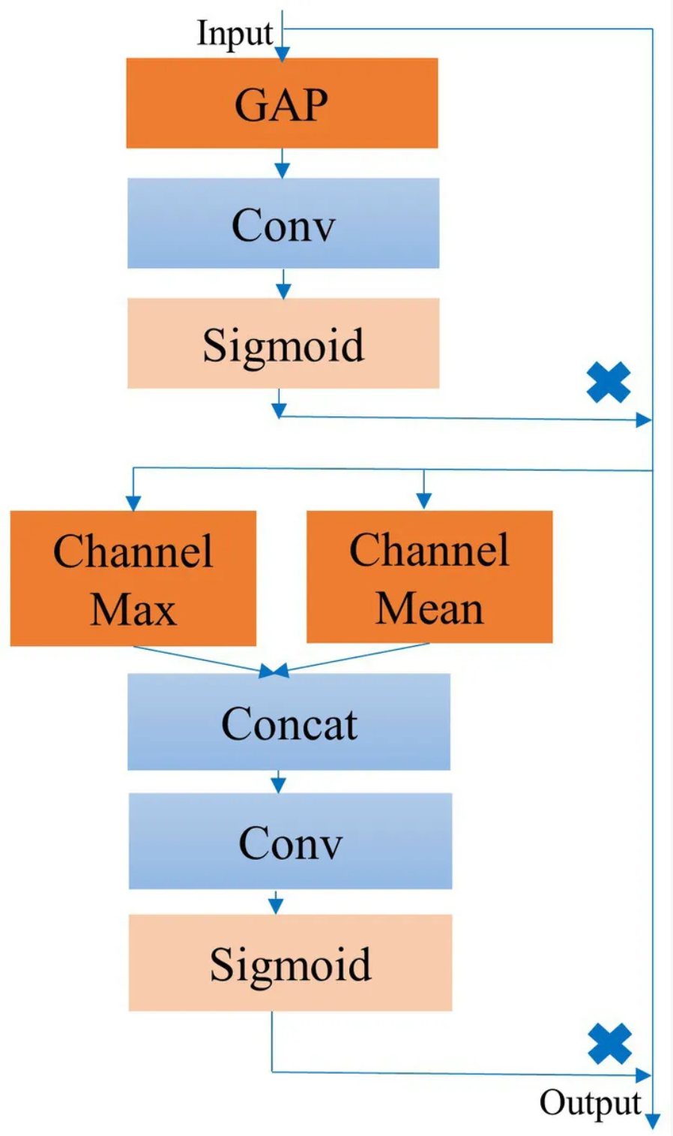
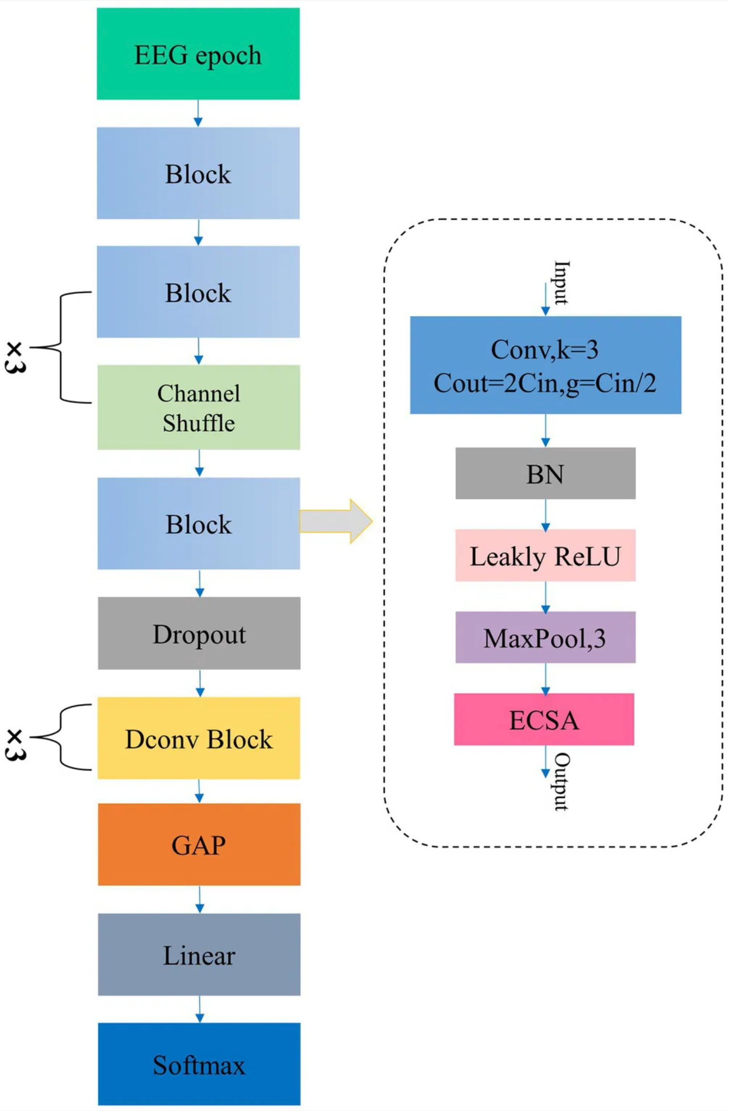
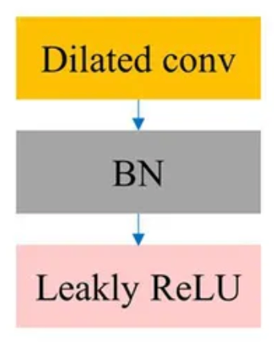
Micro SleepNet: efficient deep learning model for mobile terminal real-time sleep staging (Continued)
GAP Block Structure
Dconv Block Structure
Channels are shuffled in between every two conv operations
All activation functions are Leaky ReLU
Image credit: G. Liu et al., “Micro SleepNet: efficient deep learning model for mobile terminal real-time sleep staging,” Frontiers in neuroscience, vol. 17, Jul. 2023, doi: https://doi.org/10.3389/fnins.2023.1218072.
CSCE 714
17
University of South Carolina

Slide 18
An improved neural network based on SenNet for sleep stage classification
30-second sleep epochs to classifier (100 Hz)
Five classes wake (W), rapid eye movement (R), non-rapid eye movement phase 1 (N1), phase 2 (N2), and phase 3 (N3)
SleepEDF Dataset
Fpz-Cz Channel
84.6 % acc
0.79 Kappa
CSCE 714
18
University of South Carolina

Slide 19
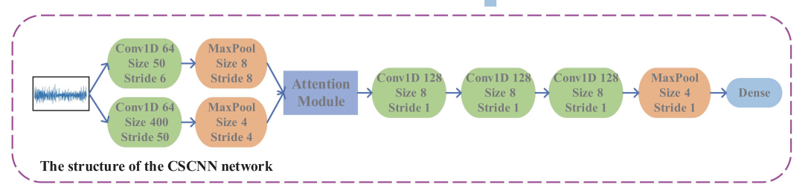
An improved neural network based on SenNet for sleep stage classification (cont.)
Two different kernel size convolution d
different feature extraction (frequency vs. time domain)
k=400 and k=50
Attention of fusion of features extracted from both
Then three more layers of convolution
Do post-processing with HMM
Image credit: [11]
CSCE 714
19
University of South Carolina

Slide 20
SCANSleepNet: A spatial-channel attention network for sleep stage classiﬁcation
30-second sleep epochs to classifier (100 Hz)
Five classes wake (W), rapid eye movement (R), non-rapid eye movement phase 1 (N1), phase 2 (N2), and phase 3 (N3)
SleepEDF Dataset
Fpz-Cz Channel
85.2 % acc
0.80 Kappa
CSCE 714
20
University of South Carolina

Slide 21
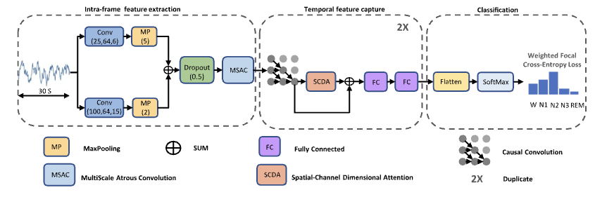
SCANSleepNet: A spatial-channel attention network for sleep stage classiﬁcation (cont.)
k=25 and k=100
100Hz / 25 = 4 (delta waves primary indicator of REM)
100Hz / 100 = 1(primary indicator of Deep Sleep N3)
Image credit: [12]
CSCE 714
21
University of South Carolina

Slide 22
Project Timeline
Task
Mar 9
Mar 16
Mar 23
Mar 30
Apr 6
Apr 13
Apr 20
Board
Design work
Model
Recreate other models
Formulate model architecture
Evaluate & fine-tune
Train our model
Update model for edge
Test edge model
Integration
Verify board w/ OpenBCI
Close data-to-model loop
Test full loop on individual
CSCE 714
22
University of South Carolina

Slide 23
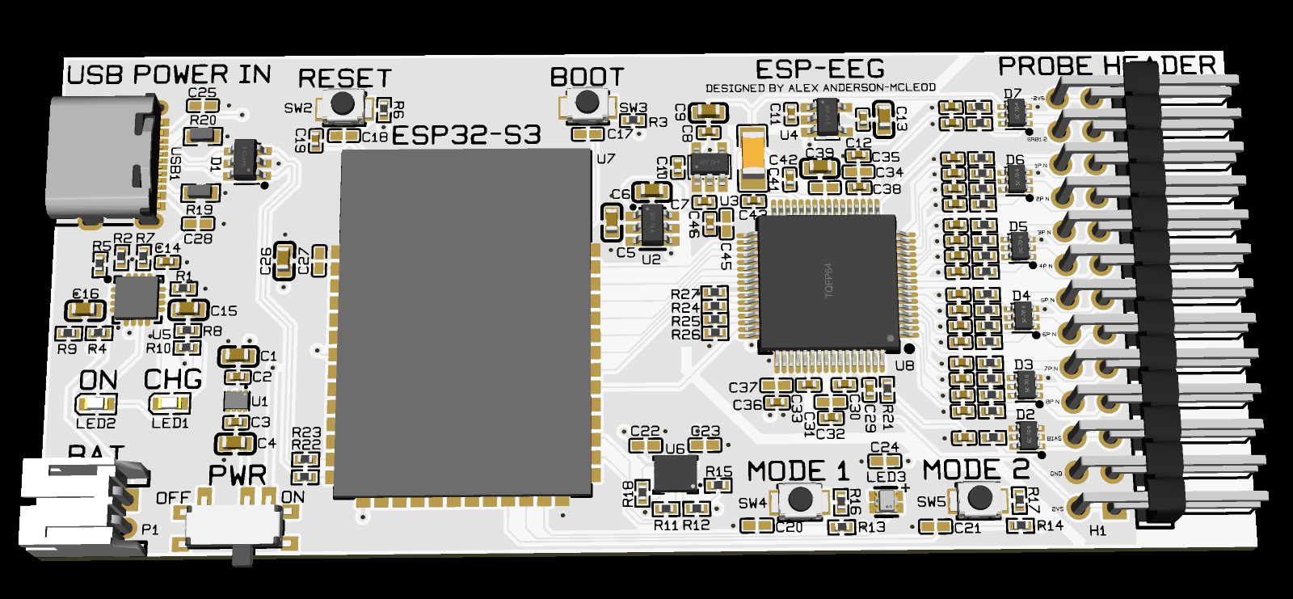
Custom EEG PCB
ESP32-based (transmits EEG data to host machine via Bluetooth)
Battery-powered with built-in charging over USB-C
ADS1299 ADC for pre-amplifying EEG signals and converting them to 24-bit digital values
CSCE 714
23
University of South Carolina

Slide 24
References
[1] A.-M. Schyvens et al., “A performance validation of six commercial wrist-worn wearable sleep-tracking devices for sleep stage scoring compared to polysomnography,” Sleep Advances, vol. 6, no. 2, Mar. 2025, doi: https://doi.org/10.1093/sleepadvances/zpaf021.
‌[2] L. Zhu, C. Wang, Z. He, and Y. Zhang, “A lightweight automatic sleep staging method for children using single-channel EEG based on edge artificial intelligence,” World Wide Web, Dec. 2021, doi: https://doi.org/10.1007/s11280-021-00983-3.
‌[3] A. Atianashie Miracle, E. Armah, and N. Mohammed, “A portable GUI based sleep disorder system classification based on convolution neural networks (CNN) in Raspberry Pi,” J. Eng. Appl. Sci. Humanities, vol. 6, pp. 13–23, 2021.
[4] G. Liu et al., “Micro SleepNet: efficient deep learning model for mobile terminal real-time sleep staging,” Frontiers in neuroscience, vol. 17, Jul. 2023, doi: https://doi.org/10.3389/fnins.2023.1218072.
CSCE 714
24
University of South Carolina

Slide 25
References cont.
[5] Zheng, N.S., Annis, J., Master, H. et al. Sleep patterns and risk of chronic disease as measured by long-term monitoring with commercial wearable devices in the All of Us Research Program. Nat Med 30, 2648–2656 (2024). https://doi.org/10.1038/s41591-024-03155-8
[6] https://my.clevelandclinic.org/health/body/12148-sleep-basics
[7] Lv YN, Cui Y, Zhang B, Huang SM. Sleep deficiency promotes Alzheimer's disease development and progression. Front Neurol. 2022 Dec 14;13:1053942. doi: 10.3389/fneur.2022.1053942. PMID: 36588906; PMCID: PMC9795181.
[8] Goldstein AN, Walker MP. The role of sleep in emotional brain function. Annu Rev Clin Psychol. 2014;10:679-708. doi: 10.1146/annurev-clinpsy-032813-153716. Epub 2014 Jan 31. PMID: 24499013; PMCID: PMC4286245.
CSCE 714
25
University of South Carolina

Slide 26
References cont.
[9] Lee YJ, Lee JY, Cho JH, Choi JH. Interrater reliability of sleep stage scoring: a meta-analysis. J Clin Sleep Med. 2022 Jan 1;18(1):193-202. doi: 10.5664/jcsm.9538. PMID: 34310277; PMCID: PMC8807917.
[10] Goldstein CA, Berry RB, Kent DT, Kristo DA, Seixas AA, Redline S, Westover MB. Artificial intelligence in sleep medicine: background and implications for clinicians. J Clin Sleep Med. 2020 Apr 15;16(4):609-618. doi: 10.5664/jcsm.8388. PMID: 32065113; PMCID: PMC7161463.
[11] J. Huang, L. Ren, X. Zhou and K. Yan, "An Improved Neural Network Based on SENet for Sleep Stage Classification," in IEEE Journal of Biomedical and Health Informatics, vol. 26, no. 10, pp. 4948-4956, Oct. 2022, doi: 10.1109/JBHI.2022.3157262.
[12] Yuyun Liu, Qilei Li, Mingliang Gao, Xiangyu Guo, and Wenzhe Zhai. 2025. SCANSleepNet: A spatial-channel attention network for sleep stage classification: SCANSleepNet: A spatial-channel attention network for sleep stage... Applied Intelligence 55, 10 (Jun 2025). https://doi.org/10.1007/s10489-025-06587-y
CSCE 714
26
University of South Carolina

Slide 27
Sleep Stage Classification Using EEG Signal Analysis: A Comprehensive Survey and New Investigation (2016) PROBABLY DELETE THIS
Older, but highly-cited (400+ citations)
Signals processed in time domain
10s epochs vs standard 20 or 30 of past
Used SleepEDF
Single channel: Fpz-Cz
Classified by wake, stage 1, stage 2, stage 3, stage 4, and REM
Filtered input signals with Butterworth band-pass filters to isolate each brainwave band (alpha, gamma, etc)
Then they apply MMD to subwindows of each epoch, where they use pythag theorem to find distance b/t the max and min EEG signal in that window, and I think these MMD results form the feature vector that go to the model
It looks like they used off-the-shelf classifiers in MATLAB (EEEEWWWWW), nothing custom for the model?
Tested a variety of different models, accuracies ranged from 74% to 93.29%
Most classifiers were really slow, on the order of tens of seconds, and only two were “quick”. Still a few seconds though.
CSCE 714
27
University of South Carolina

Slide 28
IoT-Powered Mental Healthcare: Sleep State Analyzing and Monitoring Based on EEG Signal (2025) PROBABLY DELETE THIS
Uses a similar architecture to us (ESP32 edge device transmitting to another device for processing), except the other device is a cloud server
Custom dataset
Used Fp1/Fp2/Fpz electrodes
Uses off-the-shelf EEG hardware connected to the ESP though; no custom integrated cost-saving stuff and it’s built on a breadboard (yuck)
ESP filters 60Hz power noise off the signals
Signals processed in frequency domain (FFT) and noise filtered with 15-second window size (epoch)
Tested several off-the-shelf models: SVM, FastTree, Naïve Bayes, and Logistic Regression. Classify awake/asleep, not stages
Naïve Bayes performed best, with 99.3% accuracy.
TALK here about its architecture
CSCE 714
28
University of South Carolina

